Slide 1
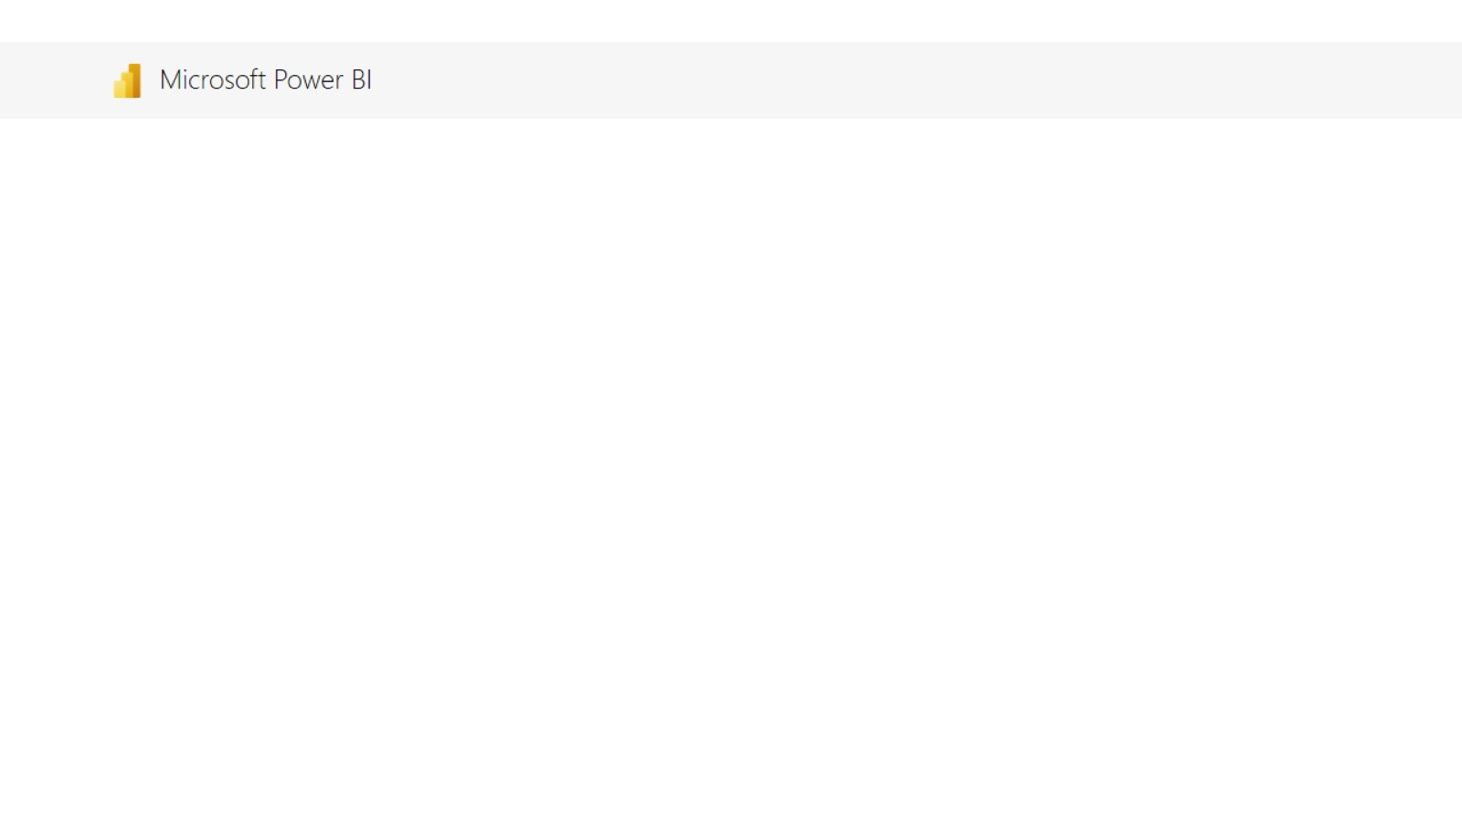
Microsoft Power BI

Slide 2
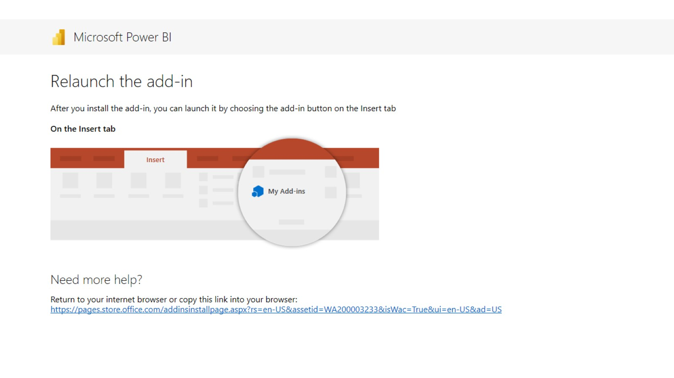
Relaunch the add-in

